Slide 1
Academy Lab Projects – Showcase
Mazen Magdy Ahmed Abdelsalam
Highly Available, Scalable Web Application
23.Oct.2024
Notes:
For Educators: You can use this template to help your students effectively present and communicate their project to a broader audience. Your students can also use this presentation as a portfolio of their work to demonstrate their cloud skills.
The presentation structure is listed below. The total time may vary depending on the activity you want to conduct. For example, you may want your students to provide high-level walkthrough of their final solutions versus deep-dive into why or how they chose certain services and the steps of building their architectures.
Suggested timing for a 15-minute presentation:
Introduction – 30 seconds
Business scenario overview – 1 minute
Solution overview – 5 minutes
Architecture diagram of the solution – 2 minutes
Demo – 5 minutes
Lessons learned – 1.5 minutes

Slide 2
Business scenario overview
Problem Statement:
University’s student records web application is slow and frequently unavailable during peak admissions periods.
High number of inquiries overwhelms the system, leading to user complaints.
Opportunity to migrate the application to AWS Cloud to enhance performance, availability, and scalability.
Solution Requirements:
Load Balanced
Scalable
Highly Available
Secure
Cost Optimized
Notes:
Define the problem or opportunity that you are addressing. Include pictures, figures, and statistics to help the audience better conceptualize the problem or opportunity.
Specify who your users or customers are and what pain points they are experiencing.
For example: “Users complain that the student admissions department website is too slow and isn’t always available.”
Also, list any specific business requirements that you are addressing.
For example: “Improve the experience for users. The web application can be deployed to the AWS Cloud. The application must be highly available, scalable, load balanced, secure, and performant architecture that can support thousands of users.“
Note:
An above-bar overview succinctly defines the problem and opportunity statement. For example: “Customers with media files, such as retail companies, need an easy and cost-effective way to analyze photos and videos of their inventory.”
A below-bar overview is too verbose, technical, or not specific. For example: “The most common media files are .jpg and .mp4. Companies have media files of their inventory.”

Slide 3
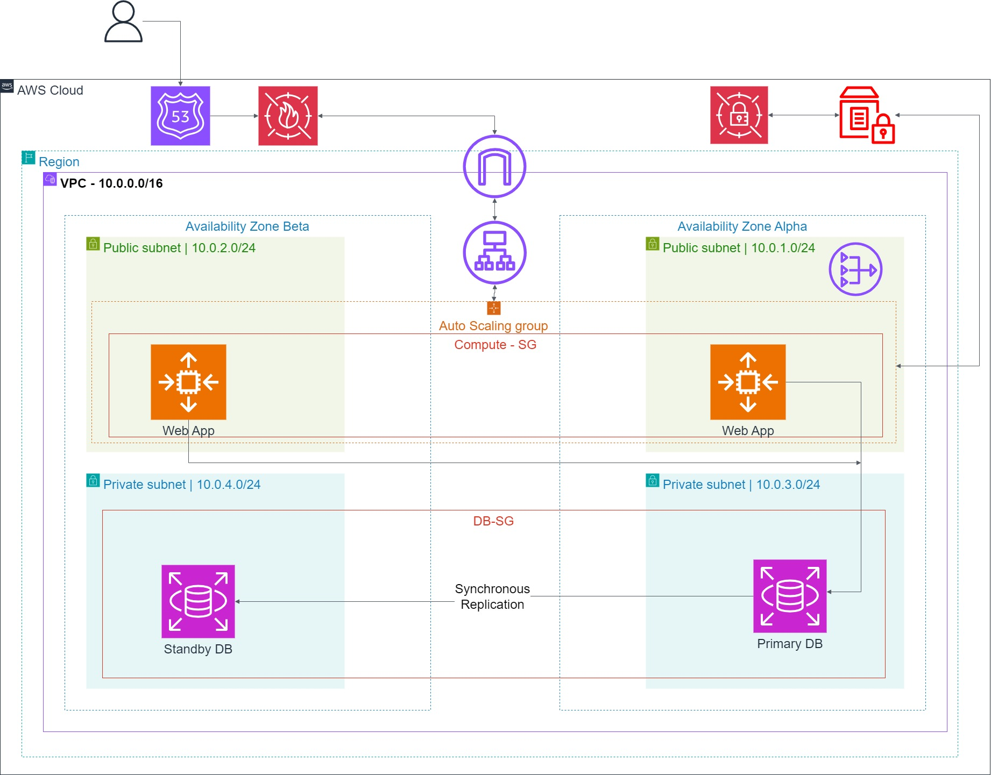
Architecture diagram of the solution
<Put your diagram here. Refer to the slide notes for more information.>
Notes:
Use the following resources to create a diagram of your application architecture:
AWS Architecture Icons at https://aws.amazon.com/architecture/icons. This page includes diagram assets as well as links to drawing and diagramming tools that you can use.
As you walk through the architecture, make sure that you relate back to the business requirements and the AWS Well-Architected Framework (https://docs.aws.amazon.com/wellarchitected/latest/framework/welcome.html).
You can also go more in depth about the design considerations and trade-offs that you made.

Slide 4








Used Services
Virtual Private Cloud
Amazon Elastic Compute Cloud
Relational Database Service
Secret Manager
Amazon Virtual Private Cloud (Amazon VPC) enables you to provision a logically isolated section of the AWS Cloud where you can launch AWS resources in a virtual network that you've defined.
(Amazon EC2) is a web service that provides resizable computing capacity—literally, servers in Amazon's data centers—that you use to build and host your software systems.
Amazon RDS simplifies setting up, operating, and scaling relational databases in the cloud with cost-efficient, resizable capacity. Amazon Aurora, a fully managed cloud-native database engine within RDS, is compatible with MySQL and PostgreSQL.
AWS Secrets Manager securely encrypts, stores, and retrieves credentials, allowing apps to access them without hardcoding. It enables secret rotation and helps manage access to IT resources and data.
AWS Cloud9 is a cloud-based integrated development environment (IDE) that you use to write, run, and debug code.
Cloud Watch
Route 53
Application Load Balance (ALB)
Cloud9
Amazon CloudWatch provides a reliable, scalable, and flexible monitoring solution that you can start using within minutes. You no longer need to set up, manage, and scale your own monitoring systems and infrastructure.
Amazon Route 53 is a highly available and scalable Domain Name System (DNS) web service.
A load balancer serves as a single entry point for clients, directing incoming traffic to multiple targets, like EC2 instances, across various Availability Zones, which improves application availability. It can also include listeners to manage traffic effectively
A cloud IDE for writing, running, and debugging code

Slide 5
Solution overview
Solution High-Level Description:
The solution is a highly available and scalable web application hosted on AWS, designed for managing student records. It uses a load-balanced, multi-tier architecture with web servers handling user interactions and a separate relational database for storing data. The application ensures efficient traffic distribution, security, and cost-effective operations.
Use Cases:
University Admissions Period: During peak admissions times, the system supports thousands of users accessing, modifying, and managing student records with no performance degradation.
Routine Maintenance: With high availability, routine updates to the application can be performed without taking the system offline.
Database Operations: Secure access to student records allows authorized users to view, add, delete, or modify records while maintaining data security.
Notes:
Explain at a high level what you have built.
For example: “I built a web application for a company to host their blog.“
Talk about why you chose certain parts of the solutions and any tradeoffs that you made. Focus on how you designed the solutions and how you applied the AWS Well-Architected Framework as part of the process (AWS Well-Architected Framework: https://docs.aws.amazon.com/wellarchitected/latest/framework/welcome.html).
For example: “I configured load balancers and auto scaling to make the application highly available and reliable.”
Include the use cases that you are addressing. Think about who your users are and how they would want to interact with your solution to solve their problem.
For example: “Users can view, upload, edit, and delete blog posts. Administrators can approve blog posts.”
Talk about the use cases that you addressed as part of the minimum viable product (MVP) that you scoped and built.
Note:
An above-bar description is concise and includes the most important benefits. For example: “The solution allows customers to quickly upload, store, and search large catalogs of images and videos in Amazon S3.”
A below-bar description is too detailed or not specific. For example: “Our solution analyzes media files.”

Slide 6
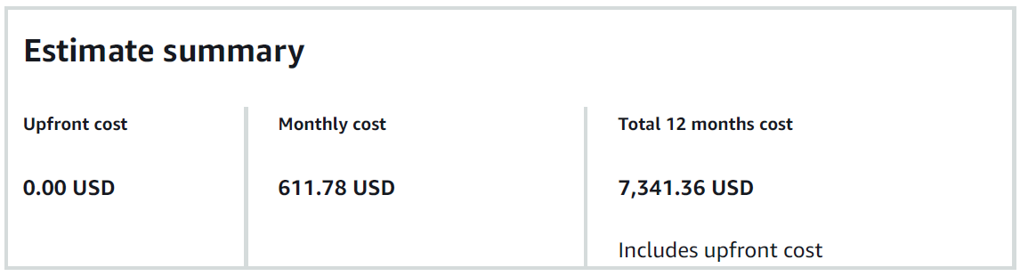
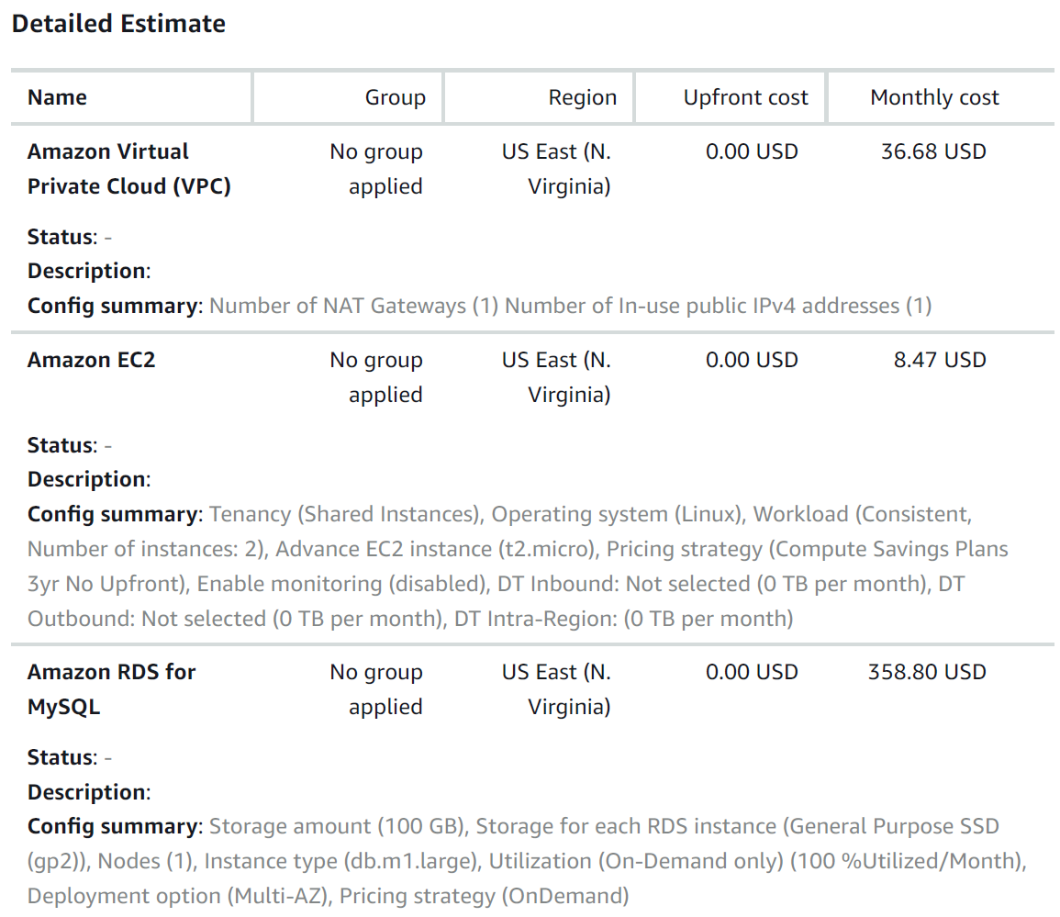
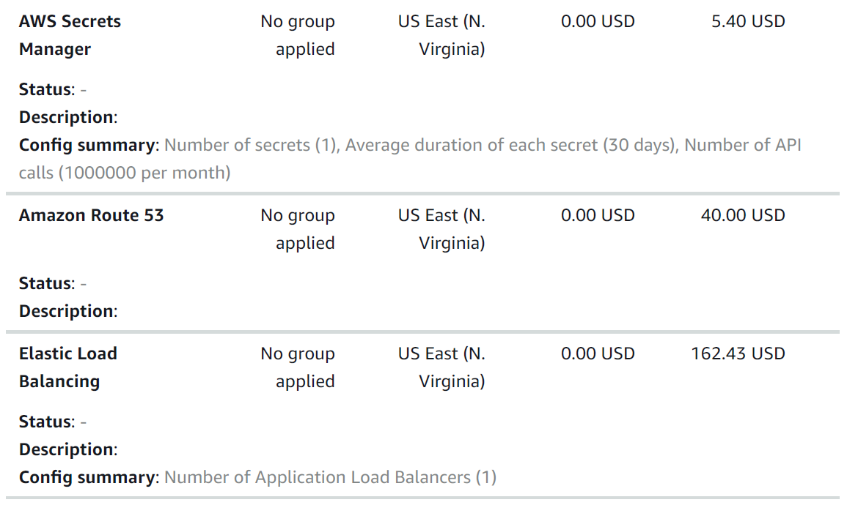
Cost Estimation
Here is an approximate cost estimation for the used services per year (12 months)

Slide 7
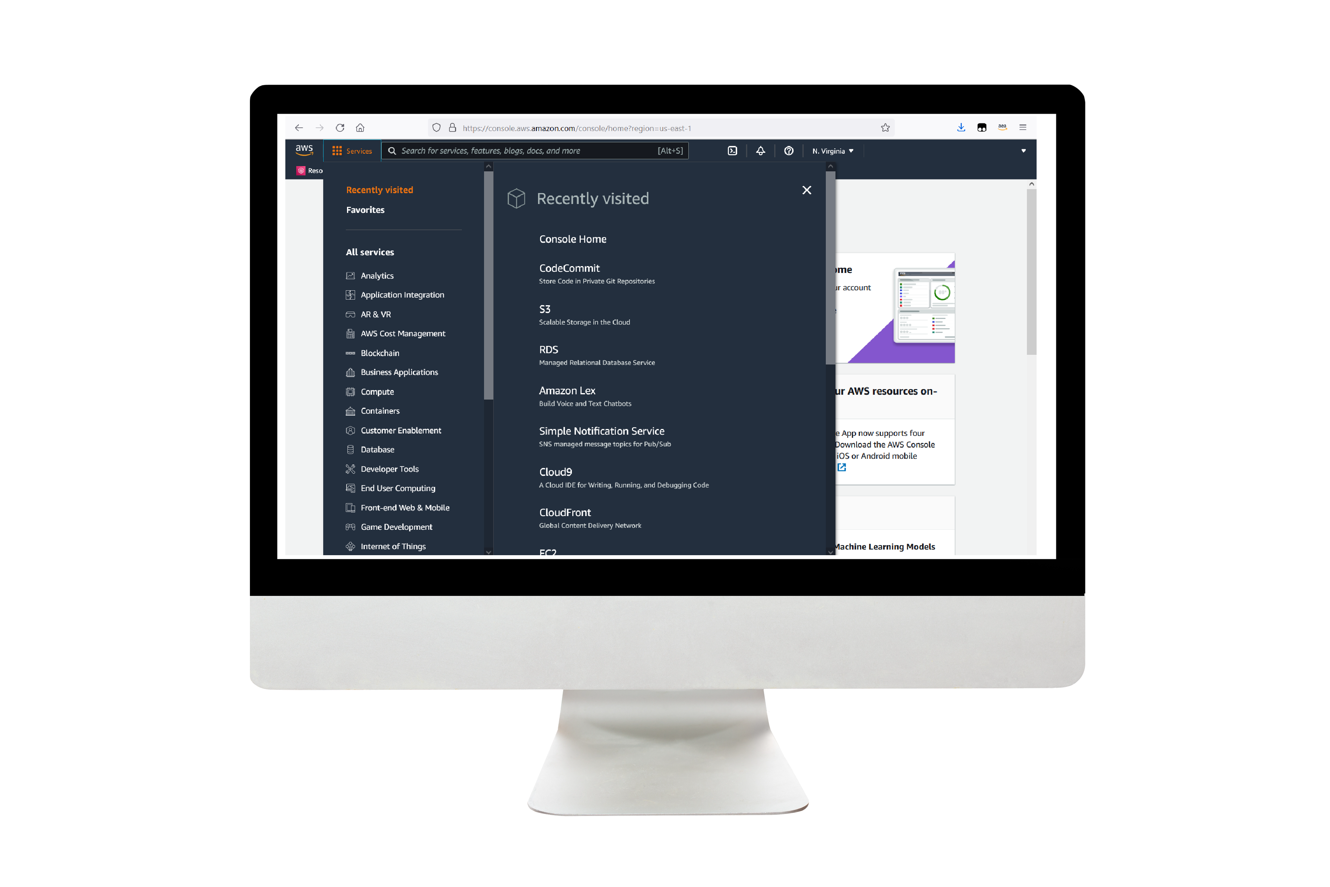
Demo
Load Balancer DNS Hyperlink
Notes:
For the demo, guide the audience through the two to three most important benefits of the solution and how it addresses the requirements.
Your demo materials can be screen captures, recordings, a link to your final solution, and/or a link to AWS console.

Slide 8
Lessons learned
Challenges Overcome:
Configuring the network for secure database access and managing Auto Scaling were initial hurdles, especially ensuring proper communication between the web servers and the database.
Helpful Resources:
AWS documentation, the AWS Pricing Calculator, and tutorials on AWS Secrets Manager and RDS were crucial in overcoming challenges and optimizing the solution.
New Skills Used:
Implementing AWS Auto Scaling, managing AWS Secrets Manager for secure credentials, and creating a multi-tier architecture with load balancing were key skills applied.
Next Steps:
Conduct additional load testing, optimize the scaling policies further, and explore integrating advanced security features like HTTPS and authentication for enhanced security.
Notes:
Describe any challenges that you encountered and how you overcame those challenges.
For example: “I got stuck when I was creating an EC2 instance to host the application. I used the resources that were listed in the instructions to walk myself through the process to create a new EC2, and I was able to complete the task. The links to labs in other courses were very helpful.”
Describe any new skills that you learned from this project.
For example: “I learned how to set up auto scaling correctly so my resources were automatically adjusted and allocated at the lowest possible cost.”
Discuss any future, out-of-scope use cases in the next steps.
For example: “I would like to scale out the web application so that multiple departments can use it.”

Slide 9
Thank you

